Slide 1
















INT104 – Database Management System Unit – II

Slide 2

Boyce Codd Normal Form (BCNF)
Trivial Functional Dependency
2

Slide 3

Acknowledgement
https://www.educba.com/functional-dependency-in-dbms/
https://www.guru99.com/dbms-functional-dependency.html
Dr. N.A. Alechina
http://www.cs.nott.ac.uk/~psznza/G51DBS09/ index.html
http://www.cs.uu.nl/staff/alechina.html
3

Slide 4

Functional Dependency
Partial FD
Transitive FD
1 NF
2 NF
3 NF
4

Slide 5

Stages of Normalisation
Unnormalised
(UDF)
Remove repeating groups
First normal form
(1NF)
Remove partial dependencies
Second normal form
(2NF)
Remove transitive dependencies
Third normal form
(3NF)
Remove remaining functional dependency anomalies
Boyce-Codd normal form (BCNF)

Slide 6
Non Trivial Functional Dependency
A Non Trivial Functional Dependency is a normal functional dependency
where the non-key attribute is functionally dependent on a primary key attribute
without the occurrence of trivial functional dependency.
X → Y, where is a non-trivial functional dependency, if and only if Y is not a subset of X

Slide 7
Non Trivial Functional Dependency
Company | CEO | Age
Microsoft | Satya Nadella | 51
Google | Sundar Pichai | 46
Apple | Tim Cook | 57
Example:
(Company} -> {CEO}
if we know the Company – infer the CEO name
But CEO is not a subset of Company
Hence it's non-trivial functional dependency.

Slide 8
Trivial Functional Dependency
Trivial Functional Dependency scenario occurs
when the primary key is formed by two columns
one of which is functionally dependent on the combined set.
X → Y, where is a trivial functional dependency
if Y is a subset of X

Slide 9
Trivial Functional Dependency
Emp_id | Emp_name
AS555 | Harry
AS811 | George
AS999 | Kevin
{Emp_id, Emp_name} -> Emp_id is a trivial functional dependency as Emp_id is a subset of {Emp_id,Emp_name}.

Slide 10
Terminologies
Super Key
Candidate Key
Prime Attribute
NonPrime Attribute

Slide 11
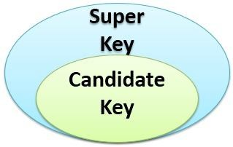
Super Key
Definition:
A super key
is a set of one or more columns (attributes)
to uniquely identify rows in a table.

Slide 12

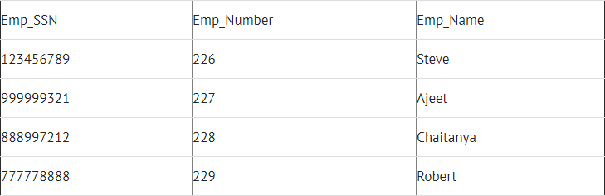
Example - Employee

Slide 13

Super Keys
{Emp_SSN}
{Emp_Number}
{Emp_SSN, Emp_Number}
{Emp_SSN, Emp_Name}
{Emp_Number, Emp_Name}
{Emp_SSN, Emp_Number, Emp_Name}
All of the above sets are able to uniquely identify rows of the employee table.

Slide 14
Candidate key
Candidate keys are selected from the set of super keys.
The only thing we take care while selecting candidate key is: It should not have any redundant data.

Slide 15
Candidate Keys
They are the minimal super keys with no redundant Data.
{Emp_SSN}
{Emp_Number}
Only these two sets are candidate keys
All other sets are having redundant Data.

Slide 16
Prime and NonPrime Attributes

Slide 17

Prime and NonPrime Attributes
Prime
Attributes that are chosen to uniquely identify any records in a table.
The values cannot be duplicated
NonPrime
Attributes other than the prime attributes.
They can store a value many times.

Slide 18
Boyce Codd Normal Form (BCNF)

Slide 19

Boyce Codd normal form (BCNF)
It is an advance version of 3NF
It is also referred as 3.5NF.
BCNF is stricter than 3NF.

Slide 20

Boyce Codd normal form (BCNF)
A table complies with BCNF
If it is in 3NF
For every functional dependency X->Y
X should be the super key of the table.

Slide 21

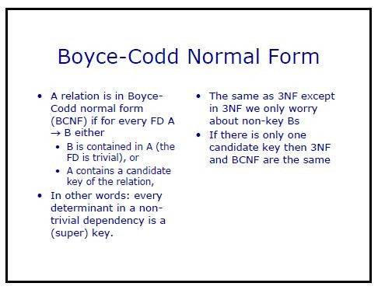
Example

Slide 22
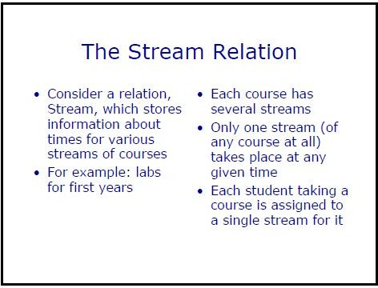
Example

Slide 23
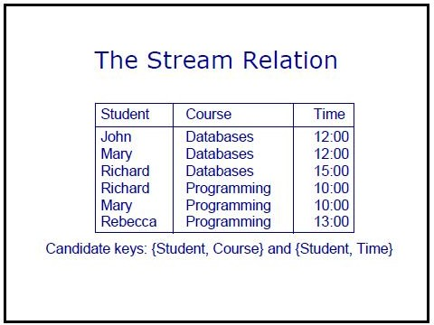
Example

Slide 24
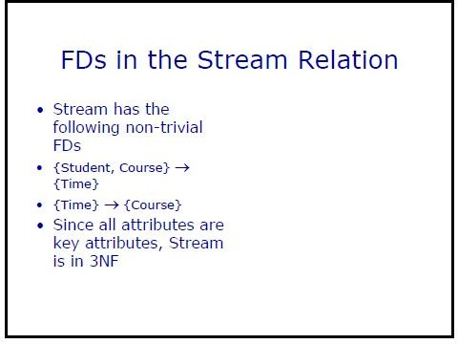
Example

Slide 25
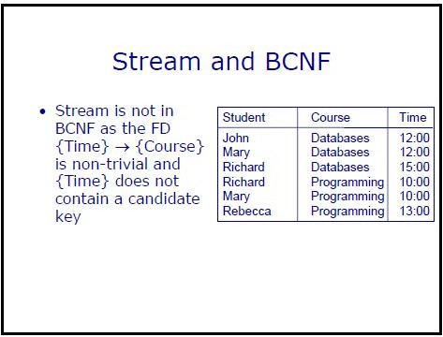
Example

Slide 26
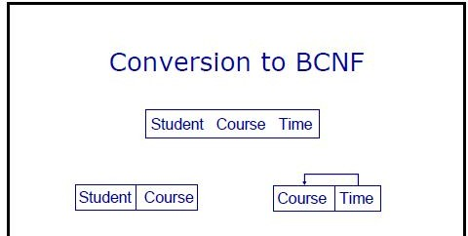
Example

Slide 27
Example
Suppose there is a company
Wherein
employees work in more than one department.
They store the data in the following format:

Slide 28
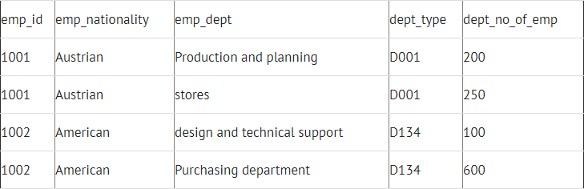
Company Table

Slide 29
BCNF
Functional dependencies in the table above:
emp_id -> emp_nationality
emp_dept -> {dept_type, dept_no_of_emp}
key: {emp_id, emp_dept}
The table is not in BCNF.

Slide 30

BCNF
To make the table comply with BCNF we can break the table in three tables as follows:
Emp_Nationality Table:

Slide 31
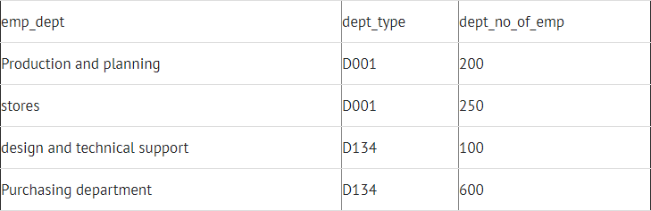
Emp_Dept Table

Slide 32

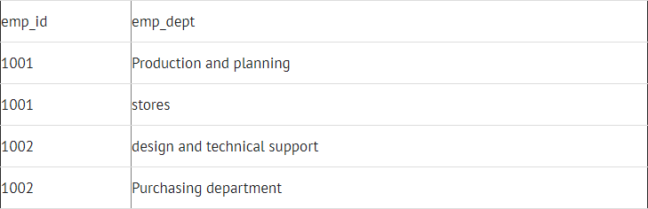
Emp_Dept_Mapping Table

Slide 33
BCNF
Functional dependencies: emp_id -> emp_nationality
emp_dept -> {dept_type, dept_no_of_emp}
keys:
For first table: emp_id
For second table: emp_dept
For third table: {emp_id, emp_dept}
This is now in BCNF
as in both the functional dependencies left side part is a key.

Slide 34

Super Key
Candidate Key
Prime Attribute
Non Prime Attribute
BCNF

Slide 35


